Slide 1
Data Visualization Strategies
Justin Joque
Nicole Scholtz
Clark Data Labs 2015

Slide 2
Overview
Introduction
Types of visualizations
Example I
Thinking about complex data
Dealing with complex data
Example II
More types of visualizations
Example III
Problems and exotic solutions
Conclusions

Slide 3
Introduction

Slide 4
Starting out
What are you trying to show?
What relationships are you interested in?
What information is unnecessary?
What do you know about your data?
Who is your audience?
What have other people done?

Slide 5

This article from the Economist discusses this map and also provides a link to a high quality reproduction of it: http://www.economist.com/node/10278643?story_id=10278643
This article from the Economist discusses this map and also provides a link to a high quality reproduction of it: http://www.economist.com/node/10278643?story_id=10278643
Notes:
This article from the Economist discusses this map and also provides a link to a high quality reproduction of it:
http://www.economist.com/node/10278643?story_id=10278643

Slide 6
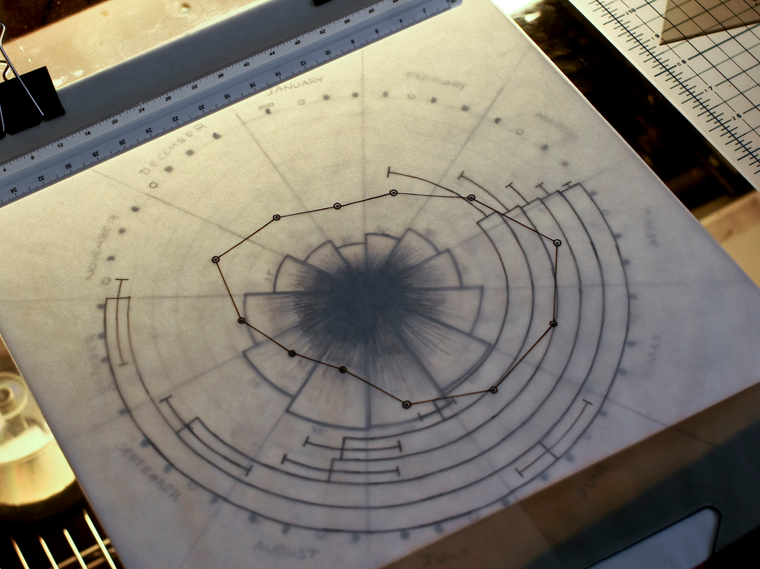

Slide 7
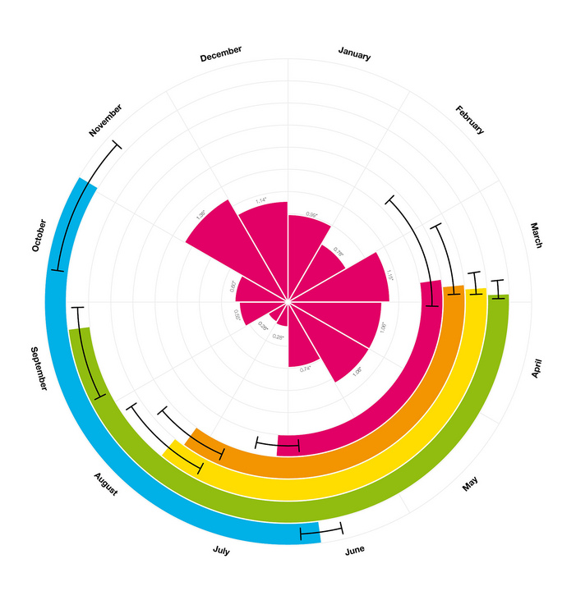

Slide 8
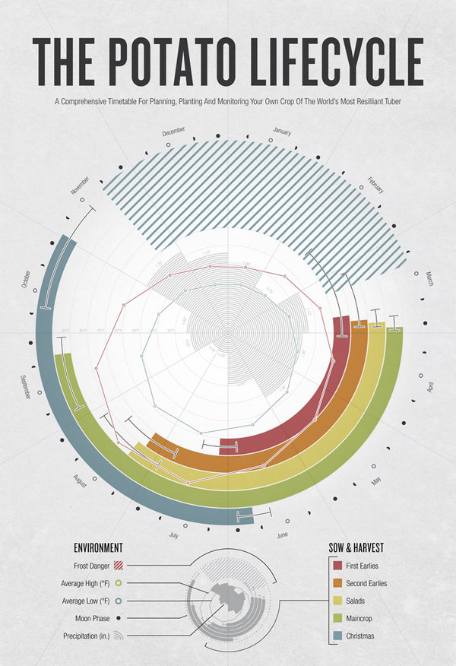
Notes:
August Miller
http://www.flickr.com/photos/augustwinfield/sets/72157624035875968/with/4597081060/

Slide 9
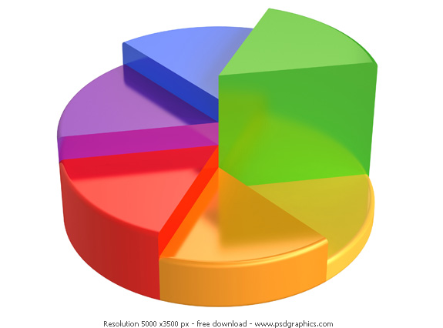
Aesthetics
Less is More

Slide 10
Approaching Visualization
Organize your data for your analysis or visualization
Design your visualization around your research question
If your visual is boring, get better data

Slide 11
Types of Visualizations

Slide 12
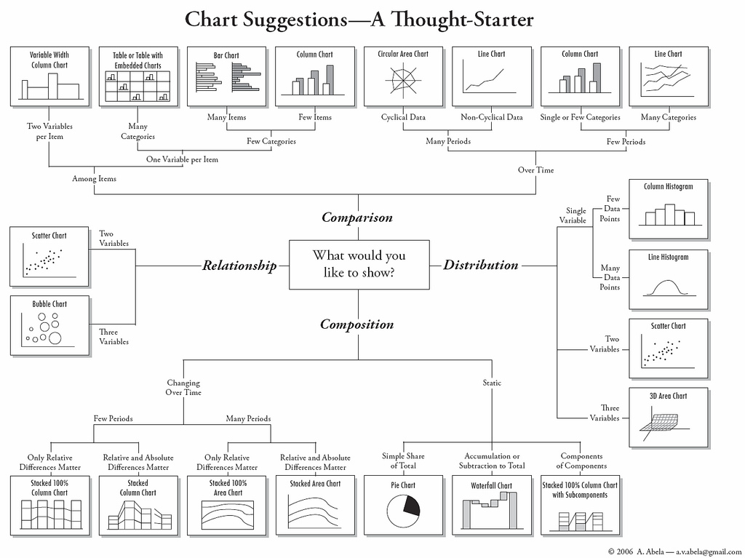

Slide 13
Histogram

Slide 14
Histogram

Slide 15
Histogram

Slide 16
Histogram

Slide 17
Scatterplot

Slide 18
What is R?
Free!
Framework for ‘data programming’
Can either use scripts or commands
Uses commands/functions with parameters
Both = and <- assign data to a variable/data frame
Large user group has created lots of plug-ins

Slide 19
Example I
Use R to create histograms and scatterplots

Slide 20
Example I
Thinking about Data
Use R to create a histogram & scatterplot

Slide 21
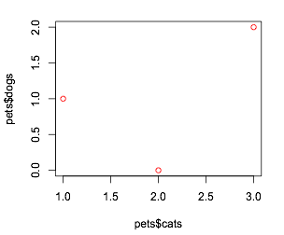
Dimensionality
 | cats | dogs
Jane | 2 | 0
John | 1 | 1
Moe | 3 | 2

Slide 22
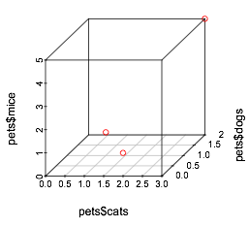
Dimensionality
 | cats | dogs | mice
Jane | 2 | 0 | 1
John | 1 | 1 | 1
Moe | 3 | 2 | 4

Slide 23
Dimensionality
 | cats | dogs | mice | birds
Jane | 2 | 0 | 1 | 1
John | 1 | 1 | 1 | 1
Moe | 3 | 2 | 4 | 5

Slide 24
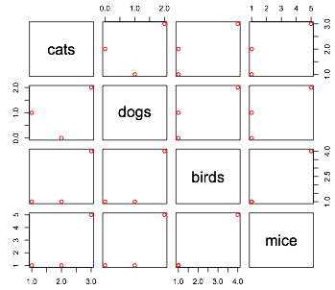
Dimensionality
 | cats | dogs | mice | birds
Jane | 2 | 0 | 1 | 1
John | 1 | 1 | 1 | 1
Moe | 3 | 2 | 4 | 5

Slide 26
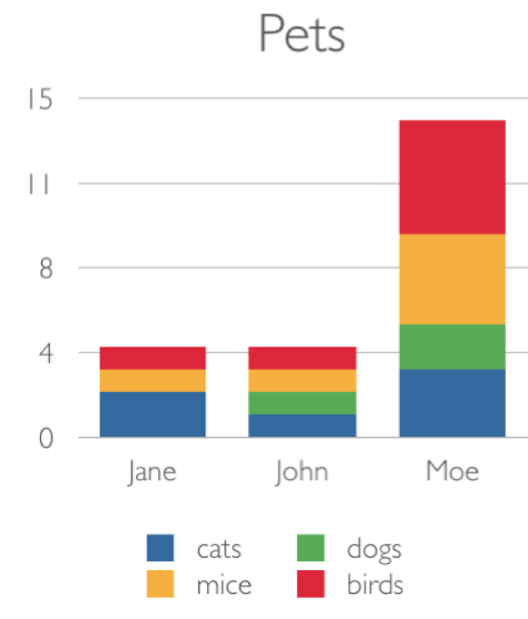
Dimensionality
 | cats | dogs | mice | birds
Jane | 2 | 0 | 1 | 1
John | 1 | 1 | 1 | 1
Moe | 3 | 2 | 4 | 5

Slide 27
Example I
Dealing with
Complex Data
Use R to create a histogram & scatterplot

Slide 28
Scaling

Slide 29
Scaling

Slide 30
Normalizing

Slide 31
Categorical vs Quantative
Dimensions
Color
Size
Time
For instance: Gap Minder www.gapminder.org

Slide 32
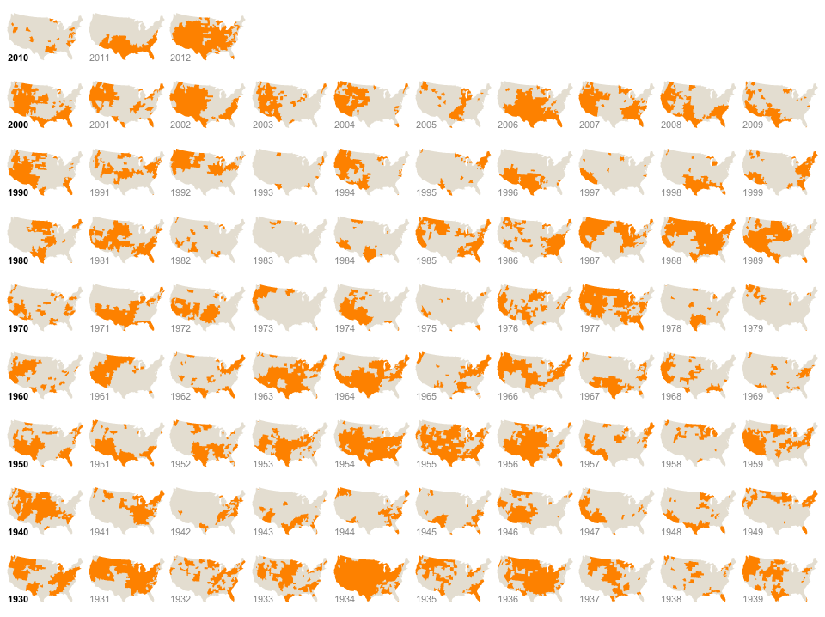
Space vs Time

Slide 33
Grouping Data

Slide 34
Aggregating data
Excel pivot tables are great for this
Use aggregate functions
Sum
Mean/Median
Variance/Standard Deviation
Often this has been done already (e.g. Census data)

Slide 35
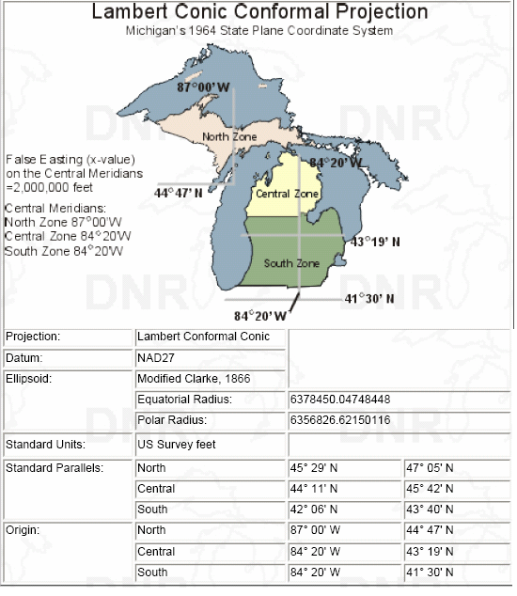
Example II
Use the provided data to make scatterplots & bubble plots

Slide 36
More Types of Visualizations

Slide 37
Box & Whisker Plot

Slide 38
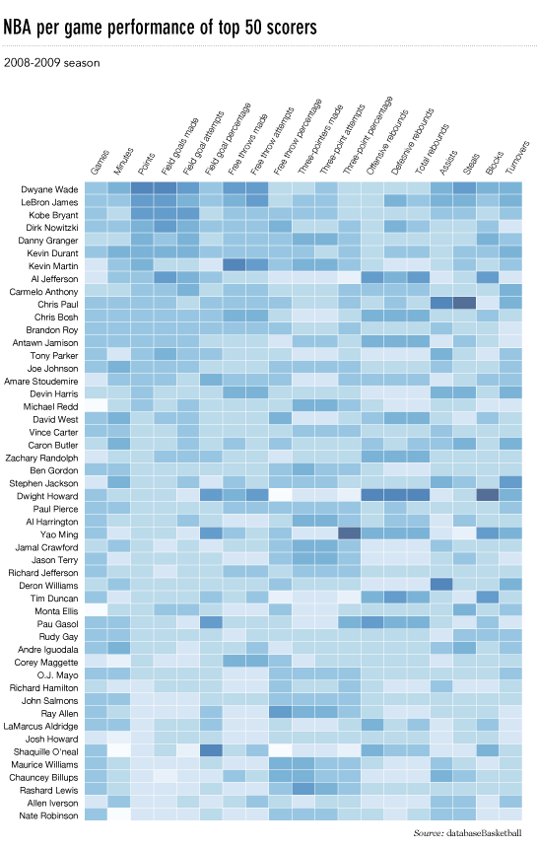
Heatmap
Notes:
http://flowingdata.com/2010/01/21/how-to-make-a-heatmap-a-quick-and-easy-solution/

Slide 39
Example III
Use the same data to create
boxplots & heatmaps

Slide 40
Problems &
Exotic Solutions

Slide 41
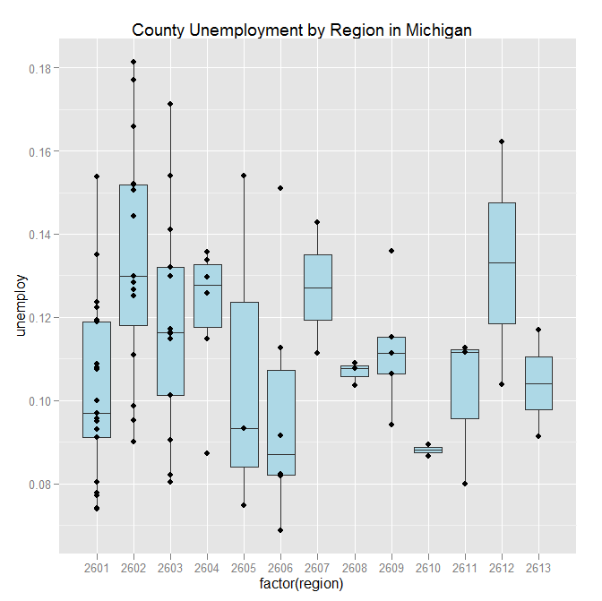
Layered Graphs
Library: ggplot2

Slide 42
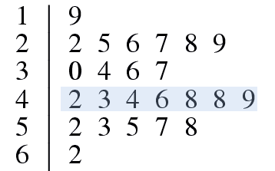
Layered Graphs
Stem and Leaf Plot

Slide 43
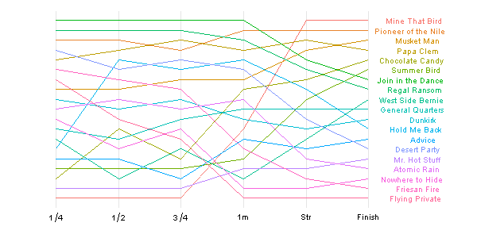
Ranking
Bump Chart
Library: ggplot2
Notes:
Source: http://learnr.wordpress.com

Slide 44
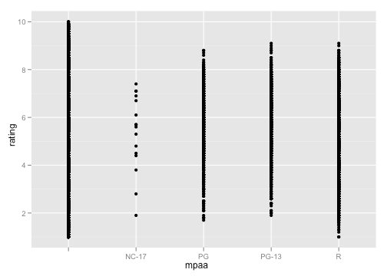
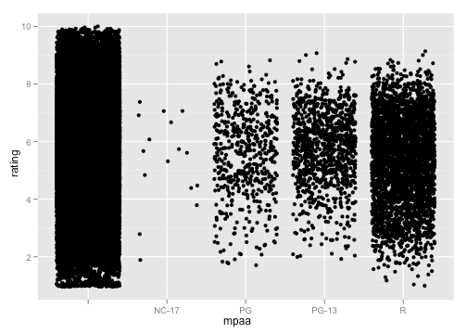
Overplotting
Jittering
Library: ggplot2

Slide 45
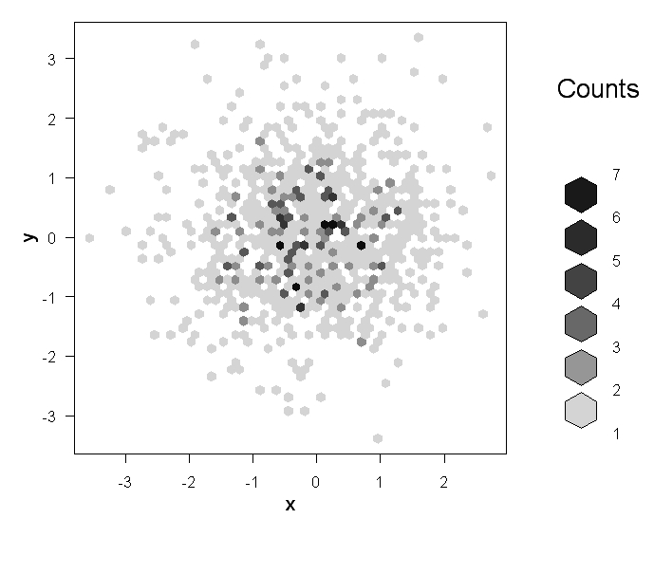
Overplotting
Hexagonal Binning
Library: hexbin

Slide 46
Conclusions

